Slide 1

Simplify Enterprise Integration with Azure Logic Apps
Thien Nguyen | NashTech
2nd December 2022

Slide 2
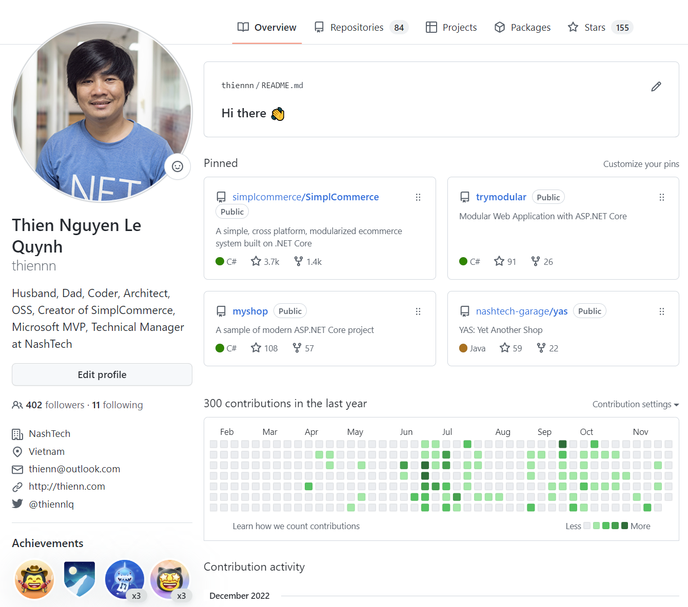
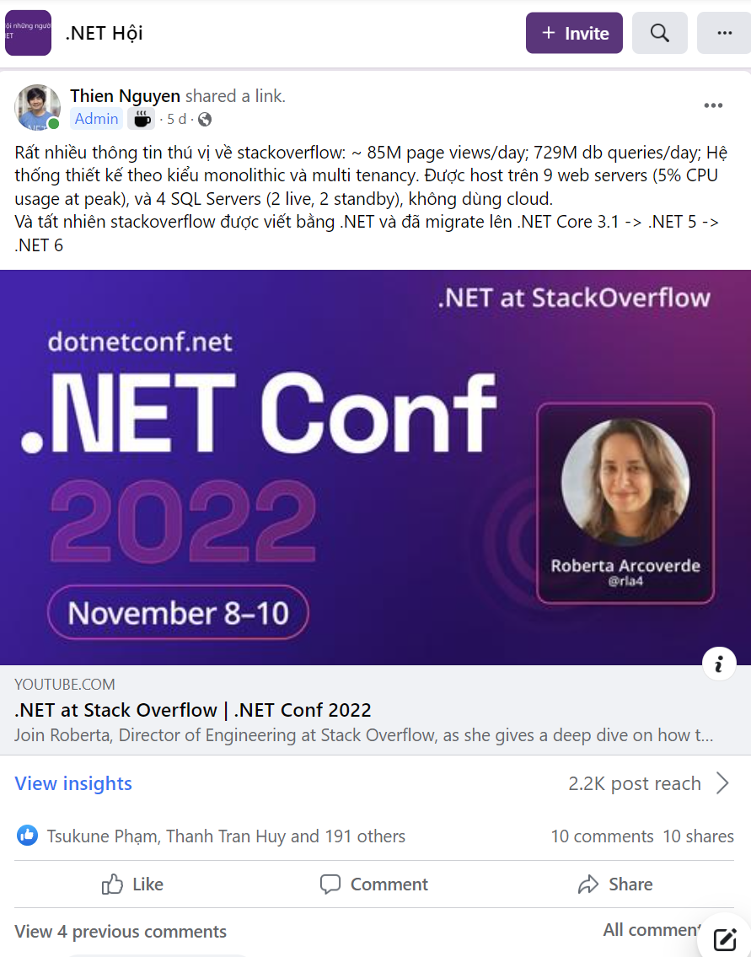
About me
https://github.com/thiennn
https://www.facebook.com/groups/dotnetvn

Slide 3
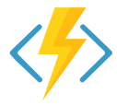

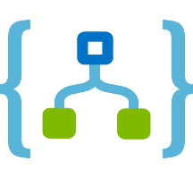
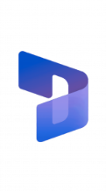

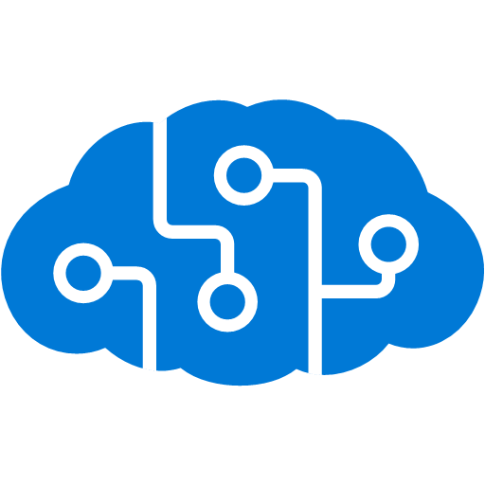



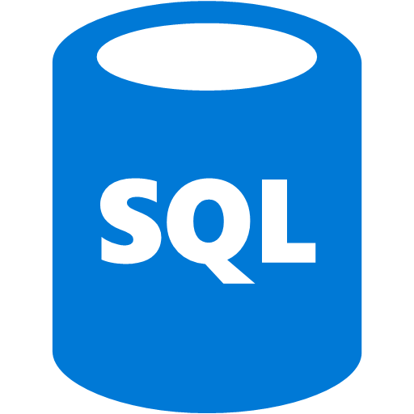



Common enterprise scenarios
On-cloud
SaaS
Microsoft 365
Azure Functions
Service bus
Dynamics 365
Cognitive services
Logic Apps
Machine learning
On-premise
On-premise data gateway
BizTalk server

Slide 4
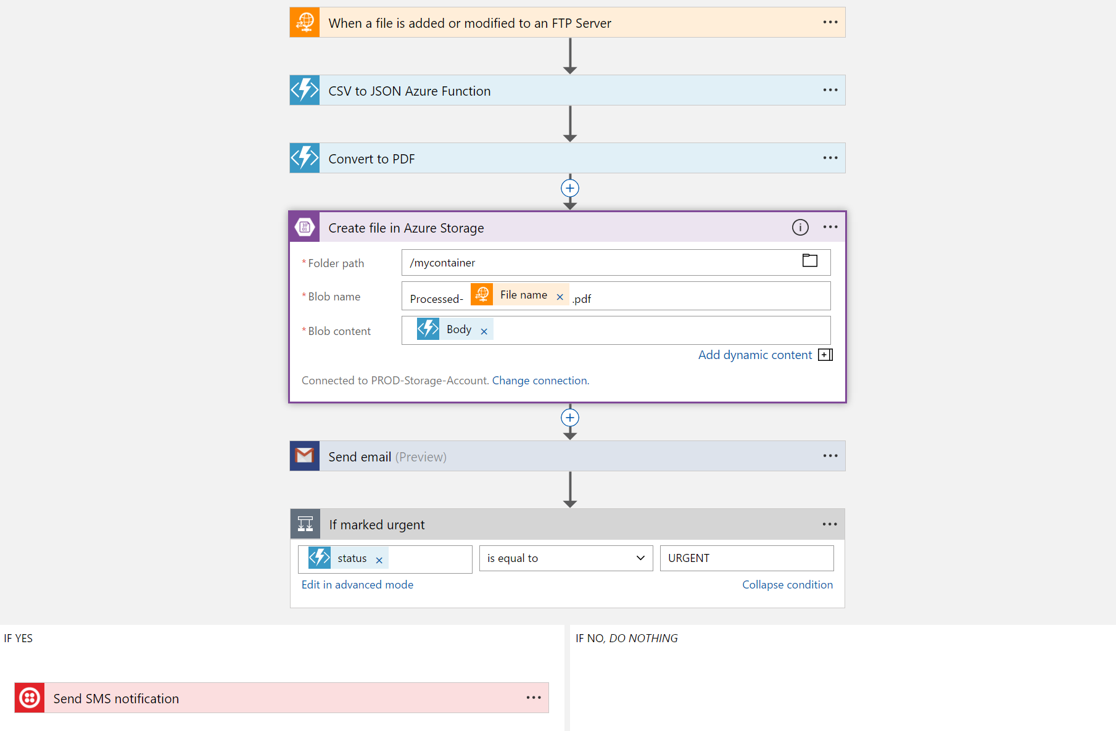
Azure Logic Apps
Azure Logic App is an integration platform with a powerful workflow engine and hundreds of prebuilt connectors
It provides low-code-no-code tools for you to develop highly scalable integration solutions for your enterprise and business-to-business (B2B) scenarios
Workflow is series a steps that defines a business process. Each workflow starts with a single trigger then flow by actions

Slide 5
Connectors
SaaS
Protocols/Native
appFigures
Asana
Azure API Management
Azure App Services
Azure Automation
Azure Cognitive Face API
Azure Cognitive LUIS
Azure Cognitive Text Analytics
Azure Cognitive Vision
Azure Data Lake Store
Azure Document DB
Azure Event Hub
Azure Functions
Azure Machine Learning
Azure Resource Manager
Azure Service Bus
Azure SQL
Azure Storage Blob
Azure Storage Queues
Basecamp
Bing Search
BitBucket
Bitly
Blogger
Box
Buffer
Campfire
Chatter
Common Data Service
Disqus
DocuSign
Dropbox
Dynamics AX Online
Dynamics CRM Online
Dynamics CRM Service Bus
Dynamics Financials
Dynamics Operations
Easy Redmine
Eventbrite
Facebook
FreshBooks
Freshdesk
GitHub
Gmail
Google Calendar
Google Contacts
Google Drive
Google Sheets
Google Tasks
GoTo Meeting
GoTo Training
GoTo Webinar
Harvest
HelloSign
Infusionsoft
JIRA
Insightly
Instagram
Instapaper
MailChimp
Mandrill
Medium
Microsoft Project Online
Microsoft Translator
MSN Weather
Muhimbi PDF
Office 365
Office 365 Users
Office 365 Video
OneDrive
OneDrive for Business
OneNote
Outlook.com
Outlook Tasks
PagerDuty
Pinterest
Pipedrive
Pivotal Tracker
Power BI
Project Online
Redmine
Salesforce
Salesforce Chatter
SendGrid
SharePoint Online
Slack
SmartSheet
SparkPost
Stripe
Survey Monkey
Todoist
Toodledo
Trello
Twilio
Twitter
Typeform
UserVoice
VS Team Services
Webmerge
Wordpress
Wunderlist
Yammer
YouTube
Zendesk
HTTP, HTTPS
HTTP Webhook
FTP, SFTP
SMTP
RSS
Compose, Query, Parse JSON
Wait
Terminate
Workflow
XML and EDI
XML Validation
Transform XML (+Mapper)
Flat File Encode
Flat File Decode
X12
EDIFACT
AS2
Integration Account Artifact Lookup
Hybrid
BizTalk Server
File System
IBM DB2
Informix
Oracle DB
SharePoint Server
SQL Server
SAP
Websphere MQ
https://learn.microsoft.com/en-us/connectors/connector-reference/

Slide 6
Demo Azure Logic Apps

Slide 7
Pricing options (reference)
Consumption
Standard (single-tenant)
Multi-tenant (shared infrastructure)
Serverless
Per-action billing ($0.000025 per action execution. First 4,000 action executions are free)
Standard Connector: $0.000125 per call
Enterprise Connector: $0.001 per call
Integration service environment (ISE)
Isolated and dedicated environment
Base unit: $6.64 per hour
Scale unit: $3.32 per hour
Pricing tiers:
WS1 (1 vCPU, 3.5 GB): $175.16 per month
WS2 (2 vCPU, 7 GB): $350.33 per month
WS3 (4 vCPU, 17 GB): $700.65 per month
Standard Connector: $0.000125 per call
Enterprise Connector: $0.001 per call
Logic Apps on Kubernetes ^{PREVIEW} (Free)
https://azure.microsoft.com/en-us/pricing/details/logic-apps/

Slide 8
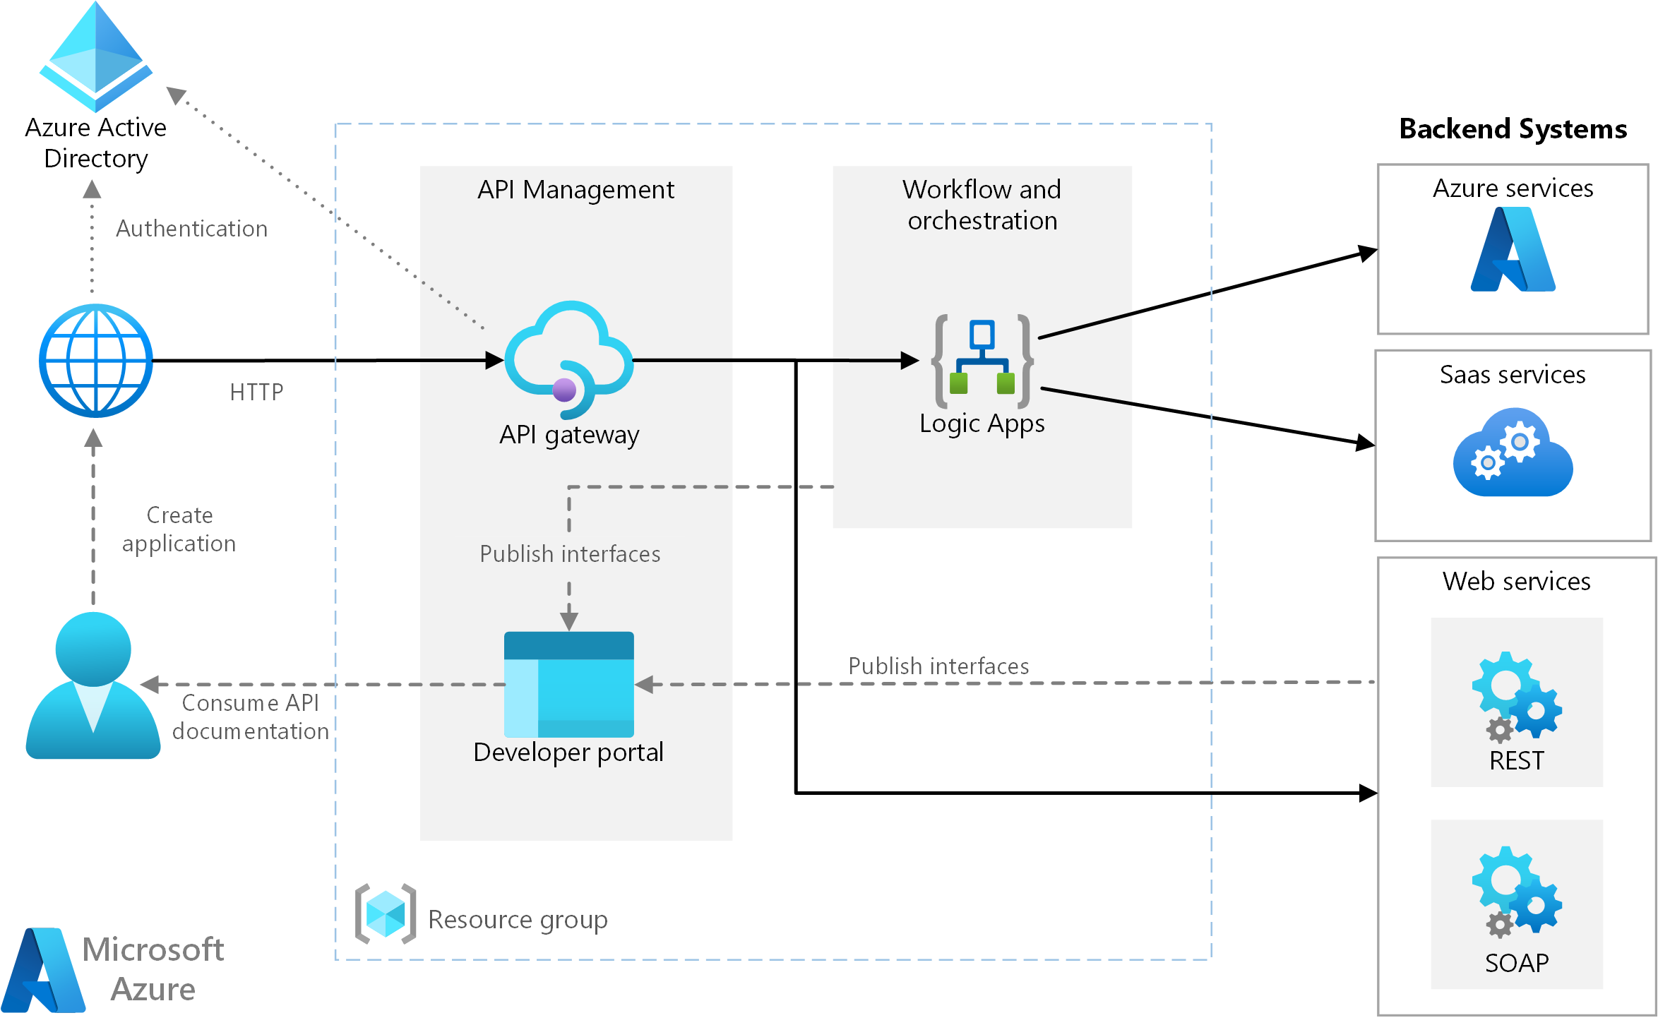
A reference architecture
https://learn.microsoft.com/en-us/azure/architecture/reference-architectures/enterprise-integration/basic-enterprise-integration

Slide 9
Azure Logic App vs Power Automate
Power Automate is built on top of Azure Logic App. They share the same workflow designer and the same connectors.
 | Power Automate | Logic Apps
Users | Office workers, business users, SharePoint administrators | Pro integrators and developers, IT pros
Scenarios | Self-service | Advanced integrations
Design tool | In-browser and mobile app, UI only | In-browser, Visual Studio Code, and Visual Studio with code view available
Application lifecycle management (ALM) | Design and test in non-production environments, promote to production when ready | Azure DevOps: source control, testing, support, automation, and manageability in Azure Resource Manager

